Slide 1

7th Grade Accelerated Math
Unit 3, Lesson 7 Equivalent Expressions Volume 1, pg. 134

Slide 2


Benchmark
MA.8.NSO.1.3
Extend previous understanding of the Laws of Exponents to include integer exponents. Apply the Laws of Exponents to evaluate numerical expressions and generate equivalent numerical expressions, limited to integer exponents and rational number bases, with procedural fluency.
volume 1, pg. 134

Slide 3
Integrated Mathematical Thinking and Reasoning Standards
MA.K12.MTR.1.1 Actively participate in effortful learning both individually and collectively.
MA.K12.MTR.3.1 Complete tasks with mathematical fluency.
MA.K12.MTR.4.1 Engage in discussions that reflect on the mathematical thinking of self and others.
MA.K12.MTR.5.1 Use patterns and structure to help understand and connect mathematical concepts.
volume 1, pg. 134

Slide 4

Learning Target
I can determine equivalency using the laws of exponents.
volume 1, pg. 134

Slide 5

Warm-Up
volume 1, pg. 135

Slide 6

3.7.1 Warm-Up: Bell Work
Evaluate each expression. Show your work.
$\frac{{(−4)}^{2}{ (−4)}^{−3}}{−4}$
${\left({\left(\frac{2}{5}\right)}^{3}\right)}^{−2}{ ∙\left(\frac{5}{2}\right)}^{−4}$
volume 1, pg. 135

Slide 7

Exploration
volume 1, pg. 135

Slide 8

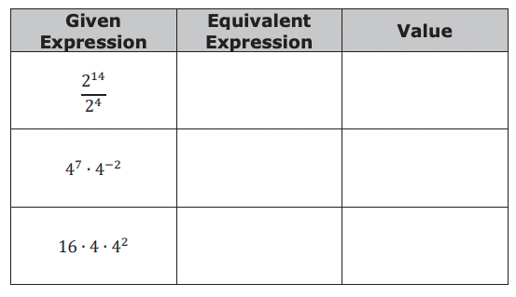
3.7.2 Exploration: Exponential Expressions with Different Bases
Three expressions are given in the table.
For each given expression, generate an equivalent expression by applying exponent laws. Then, find the value of the expression using a calculator.
Discuss your results with your partner. What do you notice about the three expressions?
volume 1, pg. 135

Slide 9

Guided Instruction
volume 1, pg. 136

Slide 10
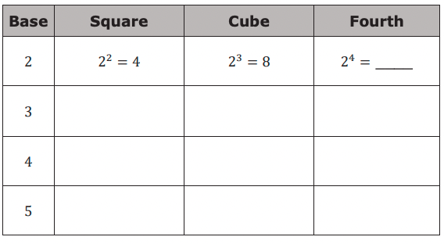
3.7.3 Guided Instruction: Rewriting Expressions with Different Bases
Exponent laws can be applied to exponents with the same base. However, sometimes a base can be rewritten to create a common base when perfect squares, cubes, fourths, etc. are present.
1. Complete the table. The first row is started for you.
volume 1, pg. 136

Slide 11
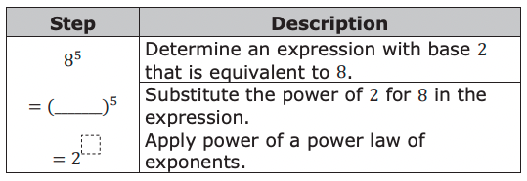
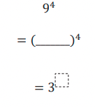

2. Write an exponential expression equivalent to $8^{5}$ that has a base of 2.
3. Write an exponential expression equivalent to $9^{4}$ that has a base of 3.
volume 1, pg. 136

Slide 12
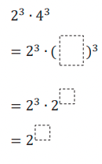
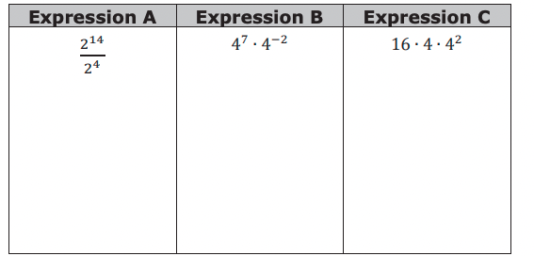

4. Complete the steps to write an exponential expression equivalent to $2^{3}$ ∙ $4^{3}$ that has a base of 2.
5. Work with your partner to rewrite each expression from the Exploration using a common base of 2.
volume 1, pg. 136

Slide 13

Guided Practice
volume 1, pg. 137

Slide 14

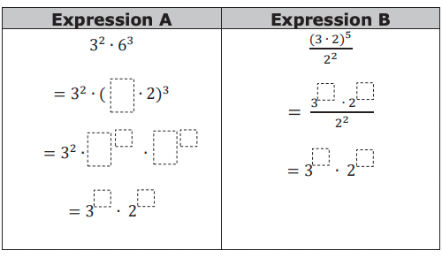
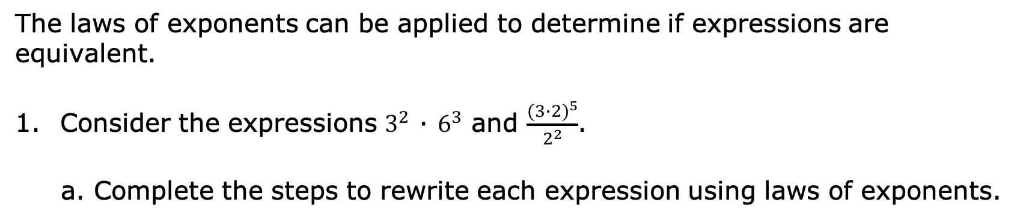
3.7.4 Guided Practice: Different Bases, Same Value
The laws of exponents can be applied to determine if expressions are equivalent.
Consider the expressions $3^{2}$ ∙ $6^{3}$ and $\frac{{(3∙2)}^{5}}{2^{2}}$.
a. Complete the steps to rewrite each expression using laws of exponents.
volume 1, pg. 137

Slide 15
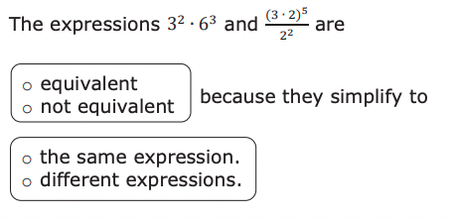
b. Complete the statement.
volume 1, pg. 137

Slide 16
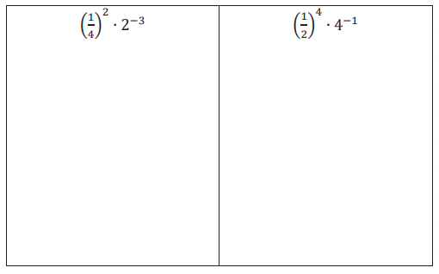

2. Xavier says the expressions ${\left(\frac{1}{4}\right)}^{2}$ ∙ $2^{−3}$ and ${\left(\frac{1}{2}\right)}^{4}$ ∙ $4^{−1}$ are equivalent because both expressions can be rewritten as $2^{−7}$ .
Generate an equivalent expression for each expression using a base of 2. Show your work.
Explain whether or not you agree with Xavier.
volume 1, pg. 137

Slide 17

Collaboration
volume 1, pg. 138

Slide 18

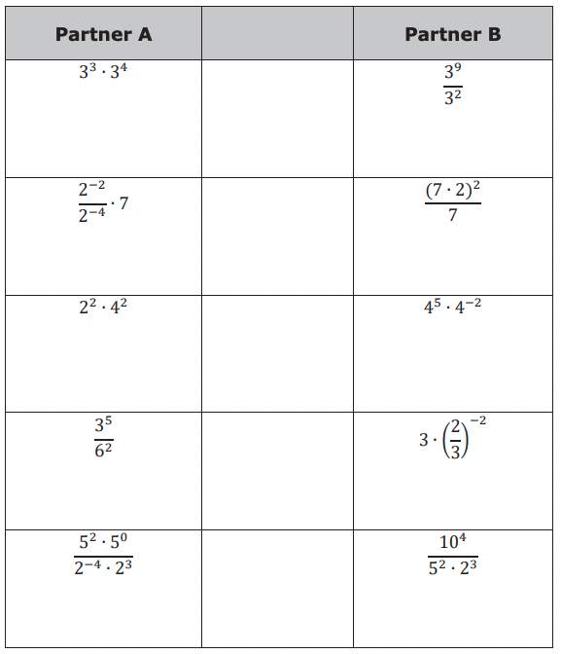
3.7.5 Collaboration: Equivalent Expressions
With your partner, determine who is Partner A and who is Partner B.
Generate an equivalent exponential expression for each expression in your column using as few bases as possible.
volume 1, pg. 138

Slide 19
b. The expressions in each row are equivalent. If your expression and your partner’s expressions are not equivalent, work together to find and correct any error(s). Then, write the equivalent expression in the middle column.
volume 1, pg. 138

Slide 20

Wrap-Up
volume 1, pg. 139

Slide 21
3.7.6 Wrap-Up: Reflection
1. Write a summary of what you learned in this lesson.
volume 1, pg. 139

